Slide 1
Windows Operating System & Command- line interface
Week 7

Slide 2
1. Learning Outcomes
By the end of this lecture you will:
Understand the Windows operating system and its function
Be familiar with both graphic and text based system manipulation
Be familiar with text based command line functions (Microsoft Windows)
1. Learning Outcomes
2. History of the Windows Operating System
3. Windows 95 & 98
2

Slide 3
2. History of the Windows Operating System
DOS - is a platform-independent acronym for Disk Operating System
MS-DOS – Microsoft’s disk-based operating system (1981)
In 1995, Microsoft released Windows 95 that was both an operating system and graphical interface.
All application software ran on top of the
operating system, including Microsoft’s Windows.
(MS-Windows = separate application that provided a
graphical user interface and tools)
1. Learning Outcomes
2. History of the Windows Operating System
3. Windows 95 & 98
3

Slide 4
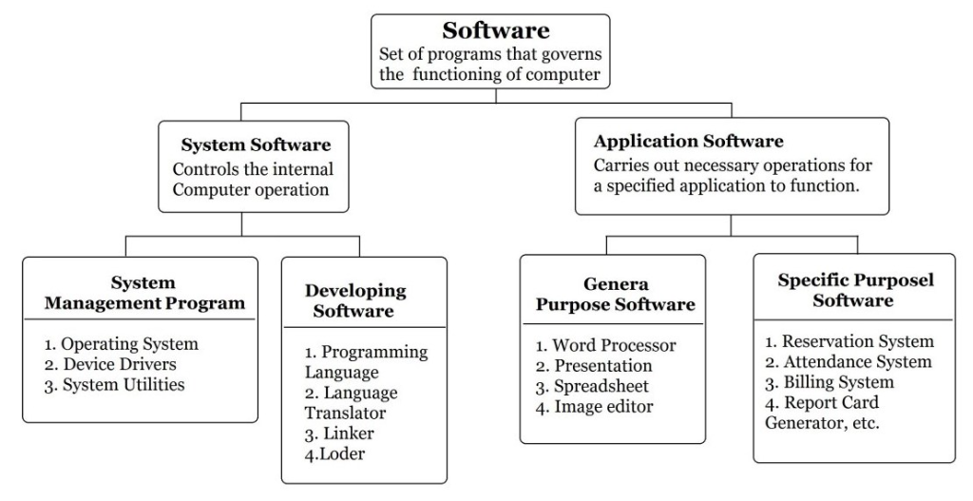
3.System Software vs Application Software.
3. System software Vs application software
4. What does an operating system do?
5. Where does the Operating System fit?

Slide 5
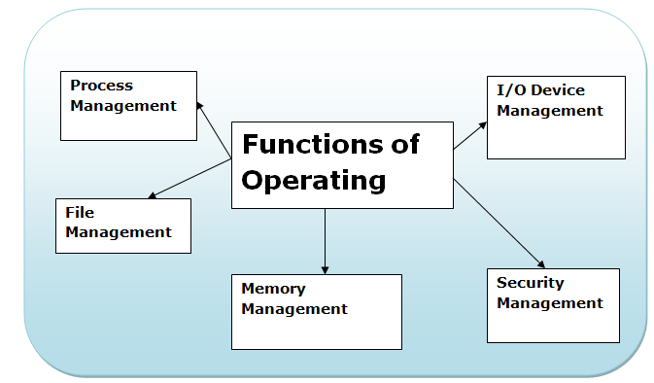
4. What does an Operating System do?
It acts as a Resource Manager
It Provides services for the applications installed (executable software)
Its key goals are:
Efficiency
Usability
3. System software Vs application software
4. What does an operating system do?
6. Where does the Operating System fit?

Slide 6
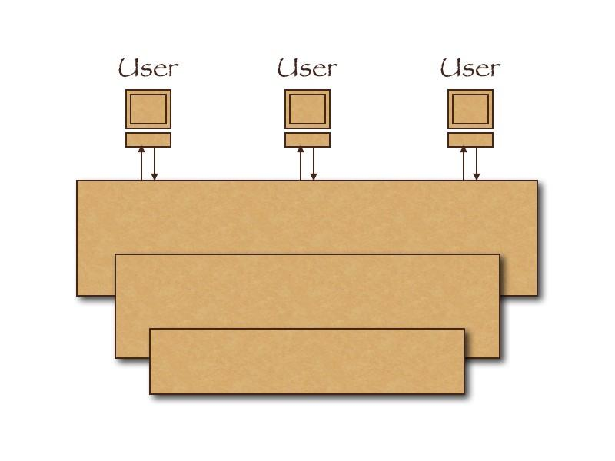
5. Where Does the Operating System Fit?
3. System software Vs application software
4. What does an operating system do?
5. Where does the Operating System fit?
6. The Kernel
Applications and Programs
Operating System
Hardware

Slide 7
6. The Kernel
Application programs
6. The Kernel
7. Talking to the Operating System
8. File System
Kernel
O/S
Device driver
Device driver
Device driver
• • • • • • •
Hardware
Kernel - “The software that contains the core components
of the operating system.”

Slide 8
7. Talking to the Operating System
Program wants to:
Read data from disc
Display data on screen
O/S can do these things
The program communicates with O/S using a System-call
a system call is how a program requests a service from an operating system's kernel
6. The Kernel
7. Talking to the Operating System
8. File System

Slide 9
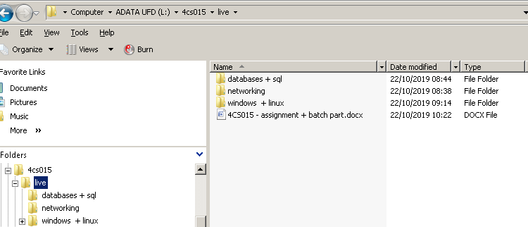
8. File System
All software applications require the use of a file system for operation
The file system contains names and locations
This will include a directory structure, made up of –
Directories (sub-directories)
Files (of different types e.g.)
.EXE (executable)[windows]
.DOCX (word)[windows]
6. The Kernel
7. Talking to the Operating System
8. File System
8.1. Why are there many File System?

Slide 10
8.1. Why are there many File Systems?
Different file systems have different ways of organizing their data.
Some file systems operate faster than others
Some have additional security features
Some are geared towards large storage capacity
Some file systems are more resistant to file corruption
8. File System
8.1. Why are there many File System?
8.2 File System development
8.3 File System: Example

Slide 11
10.2. File System development
There is usually a trade-off between many of these features:
Robustness VS Speed
Cost (always a major factor)
There’s no-one best file system for all uses
The overall goal for system developers is:
Speed (faster)
More stable (blue screen of death)
Scalable (increase size and type of device)
New functionality and features (usability)
8. File System
8.1. Why are there many File System?
8.2 File System development
8.3 File System: Example

Slide 12
8.3 File System: Example
root
8. File System
8.1. Why are there many File System?
8.2 File System development
8.3 File System: Example
modules
java
C
4cs001
4cs002
4cs003
Delimiter
Root
lect3.ppt
tutorial.doc
workshop.html
Windows - c:\modules\4cs015\lect3.ppt
Linux - /modules/4cs015/lect3.ppt

Slide 13

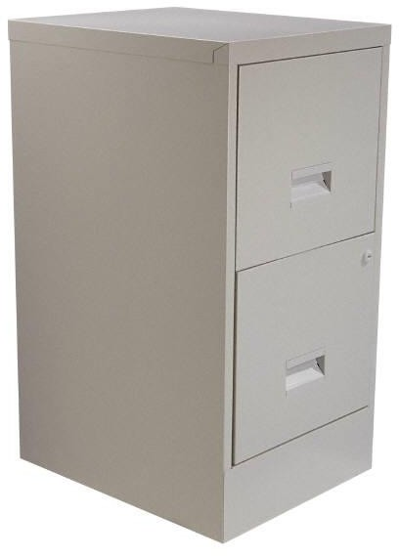

8.3 File System Example
Think of it as a filing cabinet.
Each drawer is the equivalent to a DRIVE (eg. C: E: )
8. File System
8.1. Why are there many File System?
8.2 File System development
8.3 File System: Example
Each DRIVE contains folder(s) (DIRECTORIES)
which contain individuals FILE(S)
A file

Slide 14
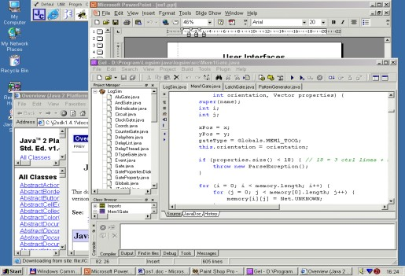
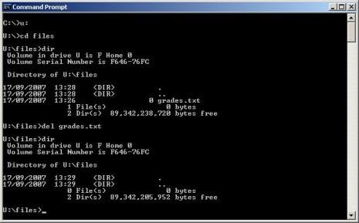
9. Using the OS (Windows)
The user tells the O/S what to through the User Interface -
Graphical
(windows + mouse)
Text based
(command line + type)
[cmd]
9. Using the OS (Windows)
10. Text Based User Interfaces
11. Command Line Interface Features
If using the command-line option a shell command(1 line) or script(multiple lines) is used
This script is interpreted (by the command line interpreter) and then actioned by the operating system.
20

Slide 15
10. Text Based User Interfaces
9. Using the OS (Windows)
10. Text Based User Interfaces
11. Command Line Interface Features
Using the Command Line Interpreter (CLI)
Uses keyboard and screen/window for all interaction
Runs (executes) as a program and waits for user to type in commands (if required)
Some functions are very powerful and extremely useful (can be dangerous / powerful – if used incorrectly – delete or format drives)

Slide 16
11. Command Line Interface Features
User commands
Manipulate file system - copy, delete, rename files and directories, etc.
Run programs, etc.
Input/output redirection
Input to program can be redirected from keyboard to file
Output from program can be redirected to a file instead of display
e.g. dir > filelist
9. Using the OS (Windows)
10. Text Based User Interfaces
11. Command Line Interface Features
12. How to use Windows OS CMD

Slide 17

12. How to use Windows OS CMD
Starting CMD -
Click: start
Type: cmd
You will be presented with the command-line interface (the wordage content will differ)
9. Using the OS (Windows)
10. Text Based User Interfaces
11. Command Line Interface Features
12. How to use Windows OS CMD
Remember –
Command lines are not case sensitive
When a file or directory is deleted it is not moved into
the Recycle Bin.
If you need help type - help
If you wish to close the cmd-line window - exit
23

Slide 18

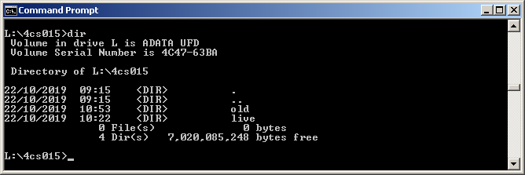
13. Features: Directory information (1)
Changing drive (from d to k) = k:
13. Features Directory information (1)
14. Features Directory information (2)
15. File Manipulation
Listing directory contents = dir
The . & .. are current and parent information respectively
For help type (many switches available) = dir /?
To changing into a directory = cd old
24

Slide 19
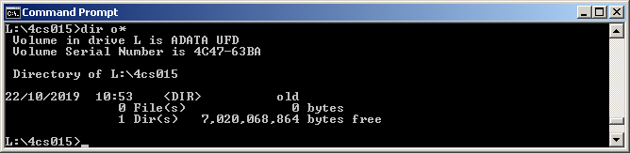
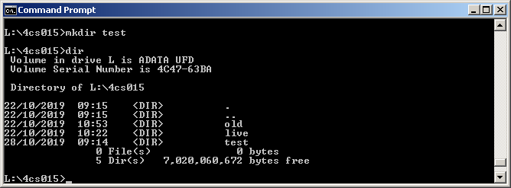
14. Features: Directory information (2)
Wildcards = dir o*
13. Features Directory information (1)
14. Features Directory information (2)
15. File Manipulation
Make a directory = mkdir test
Remove a directory = rmdir test
(or :) rd test
25

Slide 20


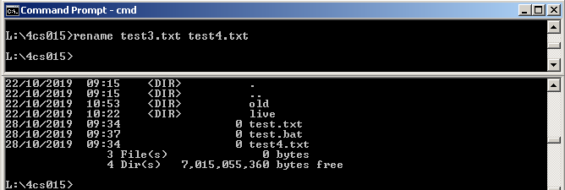
15. File Manipulation (1)
Move file = move [source] [destination ]
13. Features Directory information (1)
14. Features Directory information (2)
15. File Manipulation(1)
Copy file = copy [source] [destination ]
Rename file = rename [source] [destination ]

Slide 21


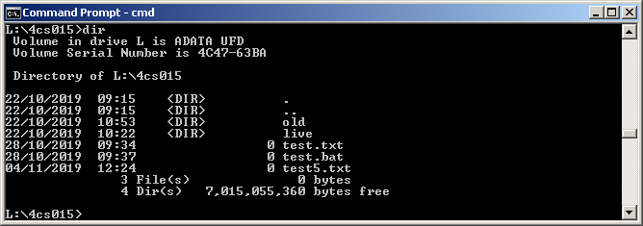
16. File Manipulation (2)
Delete file = del [filename]
16. File Manipulation(2)
17. System Interrogation and change
18. Executing Applications
19. Understanding File Extensions
Create a file = software-package [filename]

Slide 22
17. System Interrogation and change
Time [ set new time]
Date [ set new date]
Tree [ show directory structure from current location ]
Tasklist [ show all running processes and applications
Taskkill [ kill a process or application ]
Diskcopy [ copy a drive to another ] [diskcopy c: a:]
Format [ format a drive – killing all contents]
Shutdown [ close down the computer]
Very powerful commands that can be used from the command-line or called upon from within software
Run application [e.g. C:\notepad.exe ]
VB.NET, c#, etc
or Batchfile (e.g. C:\MyBatchFile.bat)
Examples coming up……..
16. File Manipulation(2)
17. System Interrogation and change
18. Executing Applications
19. Understanding File Extensions
28

Slide 23

18. Executing Applications
Run a program = application-name
e.g. notepad.exe
With or without [.exe]
With or without filename [with starts application only]
16. File Manipulation(2)
17. System Interrogation and change
18. Executing Applications
19. Understanding File Extensions
Software
package used
Name of file to be
created with extension

Slide 24
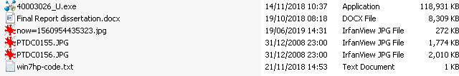
19. Understanding File Extensions
The graphical interface provides an icon that helps the user identify the type of file (associated with the software used to open a particular file) -
18. Executing Applications
19. Understanding File Extensions
20. Executing cmd-lines from software
21. Batch Files (intro….)
File name, extension, date, type, & size
Test.txt = text file (notepad)
Test.docx = microsoft word file (word)
Test.mp3 = sound file (anyplayer)
Test.mp4 = video file (anyplayer)
Test.jpg = picture file (Irfanview)
Test.exe (.com or .bat) = system executable file

Slide 25
20. Executing cmd-lines from software
C
#include <stdio.h>
int main() {
system("dir");
return 0;
}
Batchfile (see next slide for details)
@ECHO OFF :: This batch file shows directory information
ECHO Please wait...
Dir
PAUSE
18. Executing Applications
19. Understanding File Extensions
20. Executing cmd-lines from software
21. Batch Files (intro….)
31

Slide 26
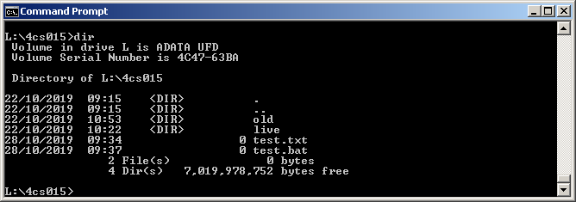
21. Batch Files (intro….)
A batch file is a script file in that can be run under
Microsoft Windows.
It consists of a series of commands executed by the command-line interpreter
It is stored in a plain text file with a .bat extension
Creating a batch file = c:\notepad test.bat (executable)
18. Executing Applications
19. Understanding File Extensions
20. Executing cmd-lines from software
21. Batch Files (intro….)

Slide 27
22. Coming up….
More on batch files in 2 weeks
time……
Next week
The Linux operating system……
Command line control……
22. Coming up…..
23. Summary
24. Workshop

Slide 28
23. Summary
Operating Systems (Windows)
Resource and service manager for the hardware
Graphical User Interface
Command Line interface
The features of a file system
Directory structures
Files and files extensions
How to use the command-line interface in the Windows OS
dir, rmdir, mkdir, etc.
How to execute command-line functions from within other programs
22. Coming up…..
23. Summary
24. Workshop

Slide 29
24. Workshop
Finish previous workshop material
Start new material on command line control (graded)
Windows command line – 25%
Linux command line – 25%
Windows batch file control – 50%
Portfolio – Submission date is week 12
22. Coming up…..
23. Summary
24. Workshop

Slide 30
31. How to use Windows CMD – Links
https://www.computerhope.com/issues
/chusedos.htm
25. How to use Windows CMD- Links

Slide 31
